Slide 1

PHP Conditional Statements
Umer Shahzad

Slide 2
PHP, conditional statements are used to make decisions in code by executing certain blocks of code only if certain conditions are met. The most commonly used conditional statements are if, else, and elseif.
Umer Shahzad

Slide 3

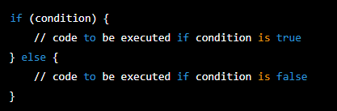
Syntax in PHP (if,else,elseif)

Slide 4
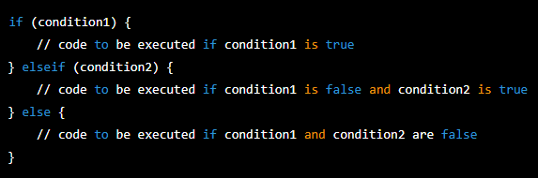
Syntax in PHP

Slide 5
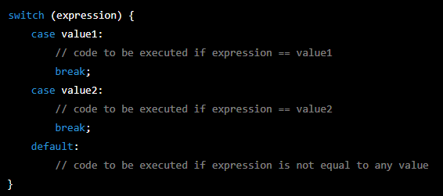
PHP Switch Statement Syntax:

Slide 6
When We Use if-Else & Switch
You can use an if-else statement when you want to check multiple conditions and execute different code based on the outcome. It's useful when you have a small number of conditions to check and the conditions are relatively simple to express.
You can use a switch statement when you want to check a single expression against multiple possible values. It's useful when you have a large number of conditions to check, and the conditions are based on the value of a single expression.

Slide 7
Important to Know:
It's important to note that the switch statement is more efficient than multiple if-else statements when you have a large number of conditions to check. However, the if-else statement may be more appropriate if the conditions to check are complex and not easily expressed with a simple comparison.
In general, you should use the if-else statement when you have a small number of conditions to check and the conditions are relatively simple to express. And you can use the switch statement when you have a large number of conditions to check, and the conditions are based on the value of a single expression.

Slide 8
Thank You! For Giving Your Important Time.

